Slide 1
Week-03
Functions and More Data Structure
Functions
By: Engr. Tushar Kanjwani

Slide 2

Agenda
Functions
Function calls
Parameters and Arguments
Built-In Functions
Type conversion Functions
Math Functions
Random Numbers

Slide 3
Function in Programming Languages
A function is simply a “chunk” of code that you can use over and over again, rather than writing it out multiple times. Functions enable programmers to break down or decompose a problem into smaller chunks, each of which performs a particular task.
Once a function is created, the details of how it works can almost be forgotten about. In this way the detail is abstracted, allowing the programmer to focus on the bigger picture.

Slide 4
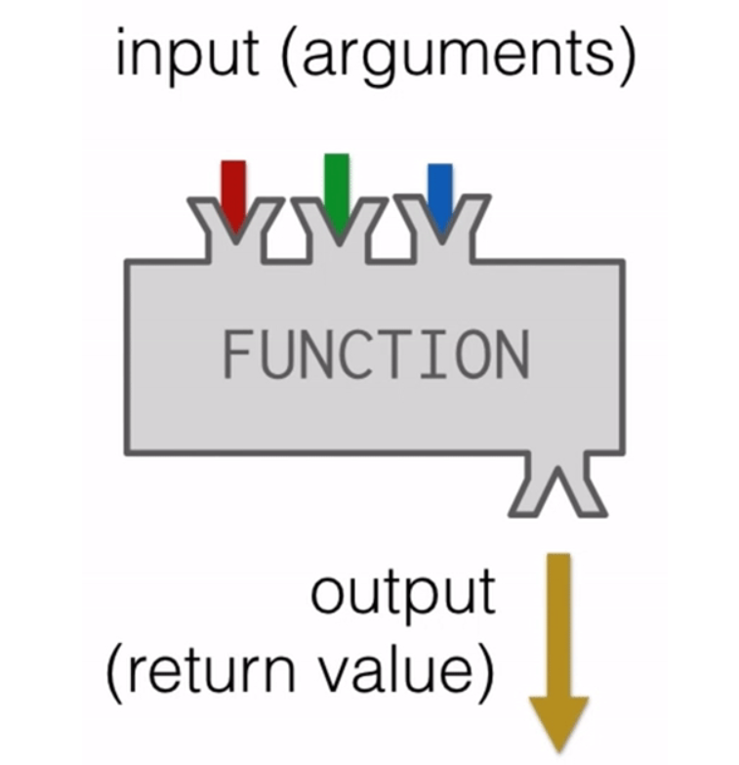
Functions?

Slide 5
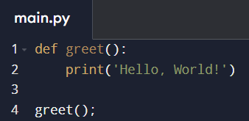

Simple program of Python using Function

Slide 6
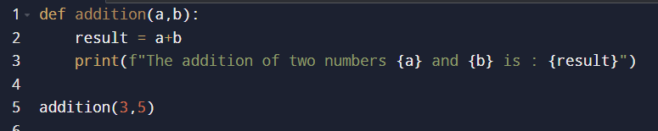
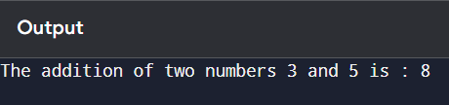
Simple program of Python using Function

Slide 7
Functions
Function calls
Parameters and Arguments
Built-In Functions
Type conversion Functions
Math Functions
Random Numbers

Slide 8
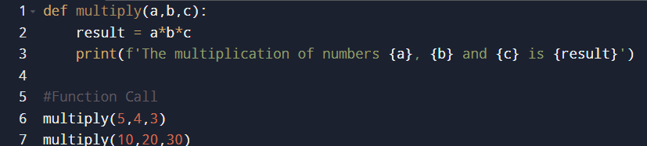
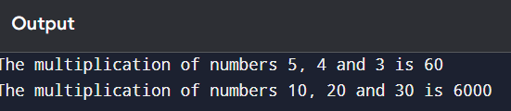
Function Calls

Slide 9
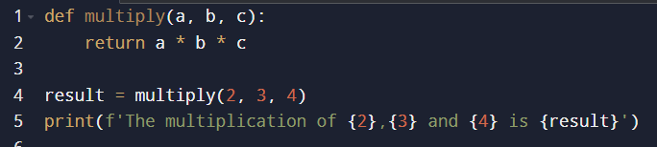
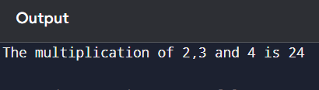
Function with Return Value

Slide 10
Functions
Function calls
Parameters and Arguments
Built-In Functions
Type conversion Functions
Math Functions
Random Numbers

Slide 11
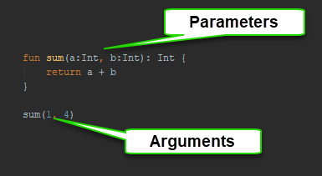
Parameters and arguments

Slide 12
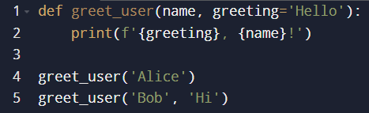
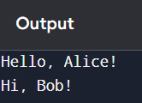
Function with Default Argument

Slide 13
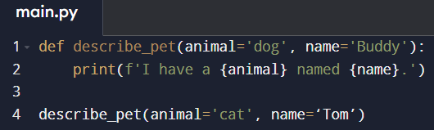
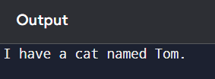
Function with Keyword Arguments

Slide 14
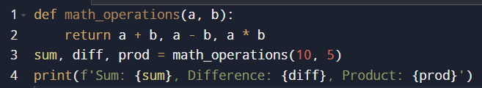

Function Returning Multiple Values

Slide 15
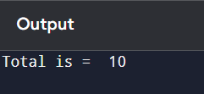
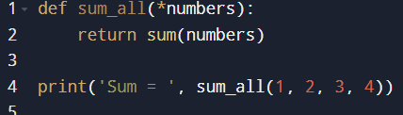
Function with Variable Number of Arguments

Slide 16
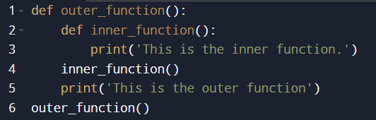
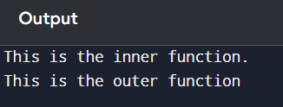
Nested Functions

Slide 17
Functions
Function calls
Parameters and Arguments
Built-In Functions
Type conversion Functions
Math Functions
Random Numbers

Slide 18
List of Built-In Functions in Python.
Function | Description
abs() | Returns the absolute value (Positive Value) of a number
bin() | Returns the binary version of a number
bool() | Returns the boolean value of the specified object
eval() | Evaluates and executes an expression
hash() | Returns the hash value of a specified object

Slide 19
List of Built-In Functions in Python.
Function | Description
pow() | Returns the value of x to the power of y
ord() | Convert an integer representing the Unicode of the specified character
round() | Rounds a numbers
type() | Returns the type of an object

Slide 20
Functions
Function calls
Built-In Functions
Type conversion Functions
Math Functions
Random Numbers

Slide 21
Type conversion function
a = 2
print(type(a))
<class ‘int’>
b= 3.0
print(type(b))
<class ‘float’>

Slide 22
Functions
Function calls
Built-In Functions
Type conversion Functions
Math Functions
Random Numbers

Slide 23
Math Functions
import math
print(math.pi)
print(math.sqrt(9))
print(math.pow(2,2))

Slide 24
Functions
Function calls
Built-In Functions
Type conversion Functions
Math Functions
Random Numbers

Slide 25
Random Numbers
import random
for a in range(2):
x = random.random()
print(x)

Slide 26
Random Integer Numbers
import random
for a in range(1):
x = random.randint(1,6)
print(x)

Slide 27
Activity-03
Write a python code which display random numbers and also find their sum. Finaly display the total sum.
Sample output:
Enter total rolls: 3
Roll 2: 2
Roll 2: 5
Roll 3: 6
Total sum: 13

Slide 28
Simple Calculator Function
def calculator(a, b, operator):
if operator == '+’:
return a + b
elif operator == '-’:
return a - b
elif operator == '*’:
return a * b
elif operator == '/’:
return a / b
else:
return 'Invalid operator' print(calculator(10, 2, '*'))

Slide 29
Function with a List Argument
Write a function `print_items(items)` that takes a list and prints each item.
def print_items(items):
for item in items:
print(item)
fruits = ['apple', 'banana', 'cherry'] print_items(fruits)

Slide 30
Function to Find Maximum
Write a function `find_max(a, b, c)` that returns the largest of three numbers.
def find_max(a, b, c):
return max(a, b, c)
print(find_max(10, 15, 5)

Slide 31
Recursive Function
Write a recursive function `factorial(n)` that returns the factorial of a number.
def factorial(n):
if n == 0:
return 1
else:
return n * factorial(n - 1)
print(factorial(5))

Slide 32
Lambda Functions
A lambda function can take any number of arguments, but can only have one expression.
Syntax
lambda arguments : expression
addition = lambda x: x + 10
print(add_lambda(5))

Slide 33
Lambda Functions
x = lambda a, b : a * b print(x(5, 6))

Slide 34
Function to Check Even or Odd
Write a function `is_even(n)` that returns `True` if the number is even and `False` otherwise.
def is_even(n):
return n % 2 == 0
print(is_even(4))
print(is_even(5))

Slide 35
Assignment Task
Simple Banking System
Write a Python function `bank_system()` that simulates a simple banking system. The user can perform the following actions:
Check Balance
Deposit Money
Withdraw Money
Exit the program
The balance should start at $0 and update after each transaction

Slide 36
Week-03 Day-02
Lists in Python
By: Engr. Tushar Kanjwani

Slide 37
Contents
List
Lists are mutable.
Traversing a list.
List operations
Activities
Tasks

Slide 38
List
A list is sequence of values.
It can contain different types of data.
Example: numbers = [2,3,4]
print(numbers)
Example: values = [1,2,”Tushar”,”Kanjwani”]
print(values)

Slide 39
Lists are mutable
The values of list can be modified
Example:
values = [3,4,“Tushar"] print(values) values[2]=“Kanjwani" print(values)

Slide 40
Traversing a List
Traversing (access each element one by one)
Example:
values = [3,4,1,“Tushar",“Kanjwani"] for a in values: print(a)

Slide 41
Accessing Elements by Index
Create a list of numbers and print the element at index 3.
numbers = [10, 20, 30, 40, 50] print(numbers[3])
print(numbers[-1])
print(numbers[:3])
print(numbers[2:])
print(numbers[::2])

Slide 42
List Operations
Combining two lists
list1 = [1,2,3] list2 = [4,5,6] combine = list1+list2 print(combine)
Multiplication of two lists
for a in range(len(list1)): list1[a] = list1[a]*list2[a] print(list1[a],end=" ")

Slide 43
List Methods
There are several methods are available for list.
Example: append,extend,sort,reverse,max,min etc.
my_list = [2,3,5,1,4] my_list.append(12)
my_list.insert(2,10)
print(my_list)

Slide 44
List Methods
Example: sort
numbers = [5,42,2,1] print(numbers) numbers.sort() print(numbers)

Slide 45
List Methods
Example: reverse
numbers = [5,42,2,1] print(numbers) numbers.sort()
numbers.reverse() print(numbers)

Slide 46
Deleting elements in List
Example:
values =[2,5,1,4] print(values) #values.pop(2) # It will be used for deleting an element from list from particular index #del values[1] # It will be used for deleting an element from list from particular index values.remove(1) print(values)

Slide 47
Lists and functions
Following functions are used in list
Example:
numbers = [10,20,40,30,50] print(numbers) print("Maximum value :",max(numbers)) print("Minimum value :",min(numbers)) print("Length of list :",len(numbers)) print("Sum of list :",sum(numbers))

Slide 48
Checking if an Item Exists in a List
Write a program to check if 'banana' is in the list of fruits.
fruits = ['apple', 'banana', 'cherry’]
if 'banana' in fruits:
print('Banana is in the list')

Slide 49
Nested Lists
Create a nested list and print the elements of each sublist using a loop.
nested_list = [[1, 2], [3, 4], [5, 6]]
for sublist in nested_list:
print(sublist)

Slide 50
Assignment Task
Shopping List Application
Write a Python program to create a shopping list. The program should allow the user to:
Add items to the list.
Remove items from the list.
View all items in the list

